Slide 1
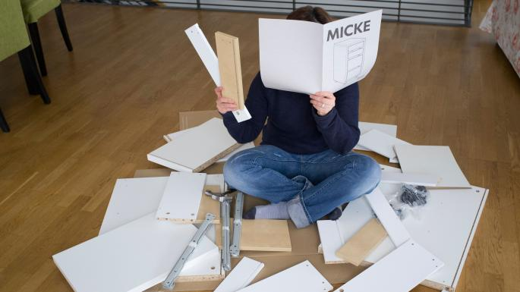
DIY metaphor

Slide 2
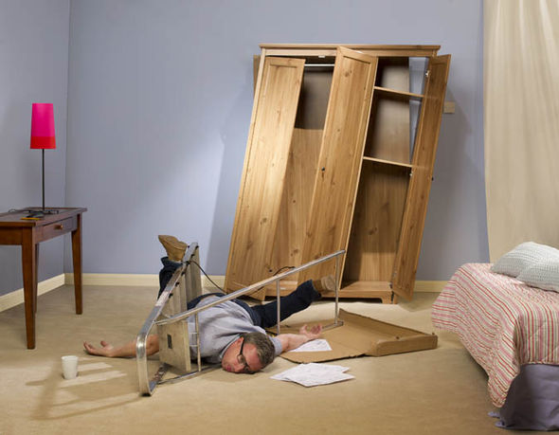
Doing DIY when stressed…

Slide 3
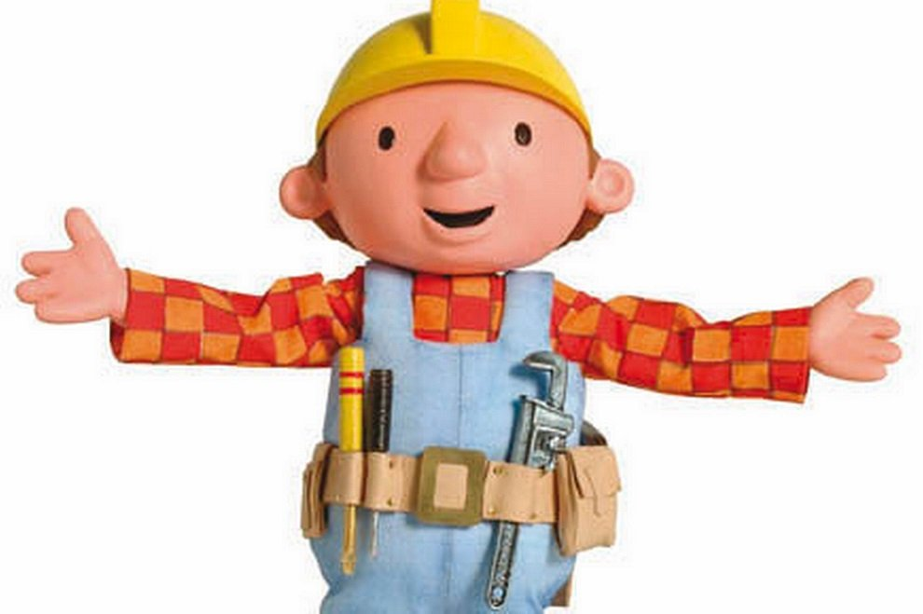
Doing DIY when you’re less stressed… means more likelihood of success…

