Slide 1

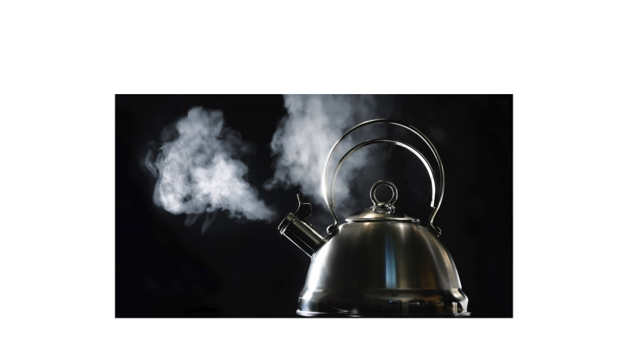
Kettle metaphor … takes time to boil a kettle

Slide 2
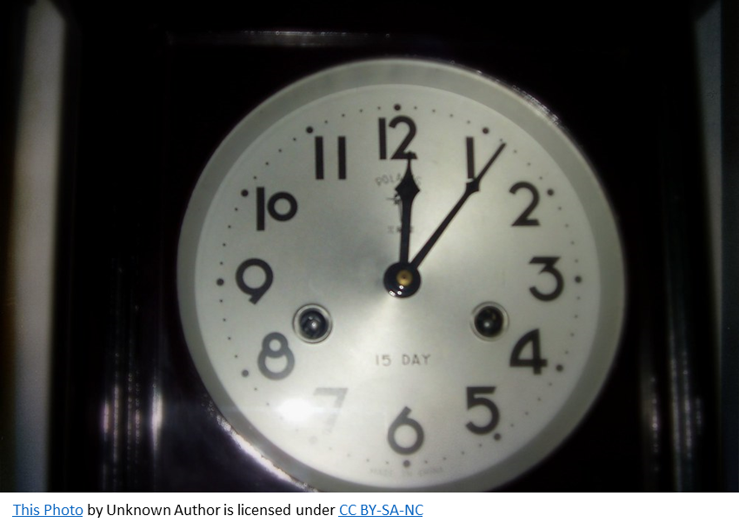
The 1st time may take a few minutes..

Slide 3
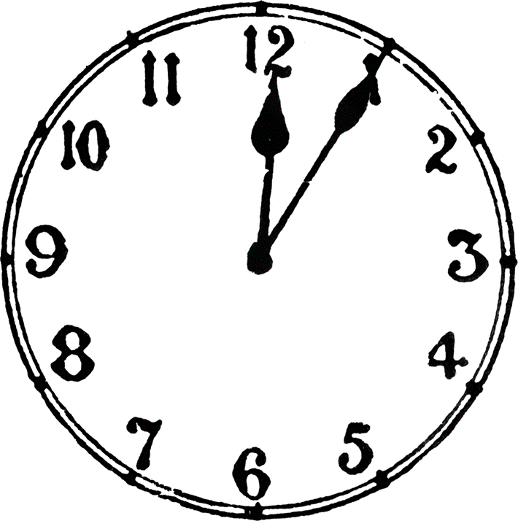
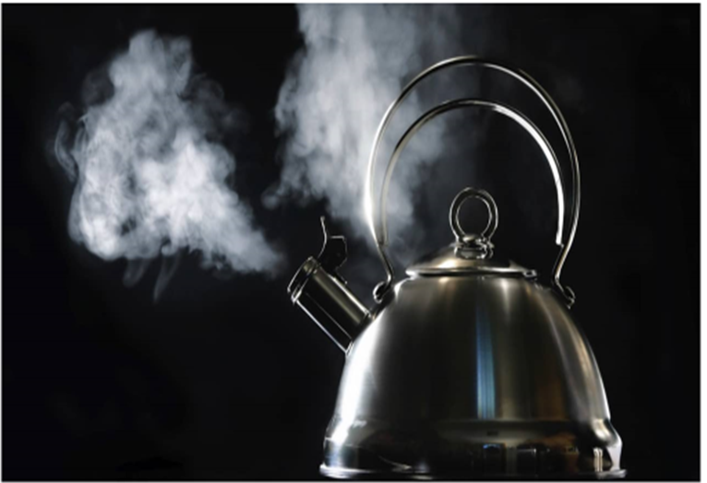
Quicker the 2nd time

