Slide 2

Rules of giving a consequence
Who has ownership of the problem

Slide 3
Rules of giving a consequence
Who has ownership of the problem
Give consequences with sadness and empathy

Slide 4
Rules of giving a consequence
Who has ownership of the problem
Give consequences with sadness and empathy
Wipe the slate clean

Slide 5
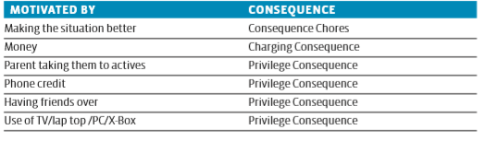
Motivation influences

Slide 6

Consequence chore (‘job’s’)

Slide 7
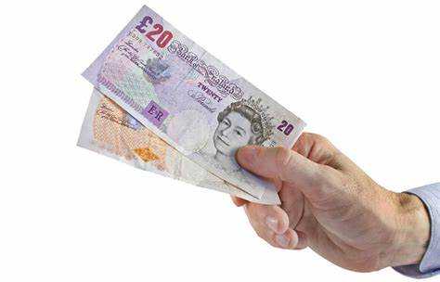
Charging teenagers

Slide 8
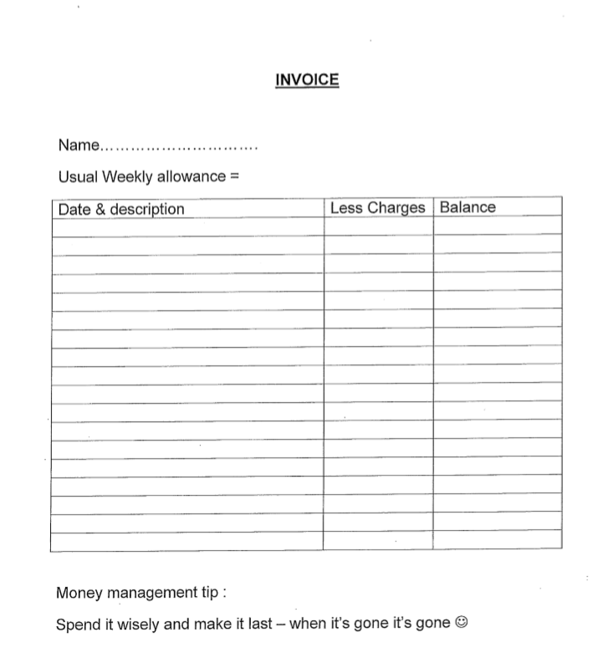

Slide 9
Invoice
Name: Jane
Weekly allowance: £15
Date and description | Less charges | Balance
Monday 7th June – Up late and required lift to school | £1 | £14
Wednesday 9th June - Up late and required lift to school | £1 | £13
Thursday 10th June – Missed friends lift to dance class and required lift to dance lass | £1 | £12

Slide 10
Invoice
Name: Tom
Weekly allowance: £20
Date and description | Less charges | Balance
Friday 11th June – did not clean room as agreed – Cleaning undertaken by mum | £5 | £15

Slide 11

Privilege consequences

