Slide 1
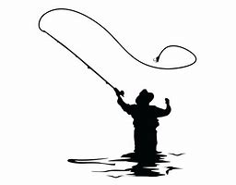
Fisherman … casting out the hook

Slide 2

Who is the fish and what is the hook ?

Slide 3

Hooking you in …

