Slide 1


Types of parent

Slide 2
What type of parent am I ?

Slide 3
Helicopter

Slide 4
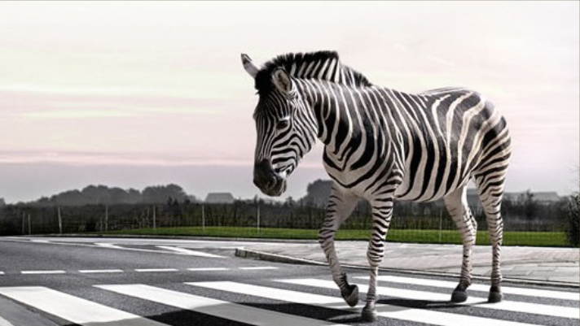
What type of parent am I ?

Slide 5
Zebra crossing parent

Slide 6

What type of parent am I ?

Slide 7
Miner parent

Slide 8

What type of parent am I?

Slide 9
Unplugged

Slide 10
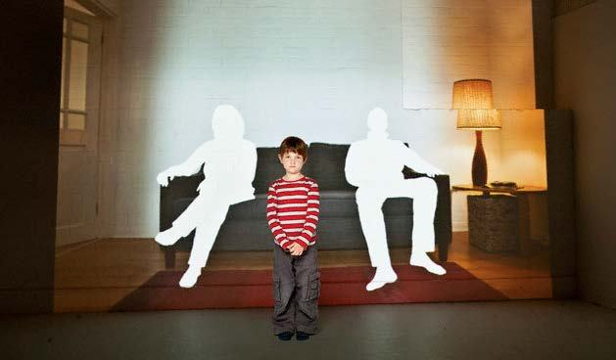
What type of parent am I ?

Slide 11
Absent parent

Slide 12

What type of parent am I ?

Slide 13
Consultant parent

