Slide 1
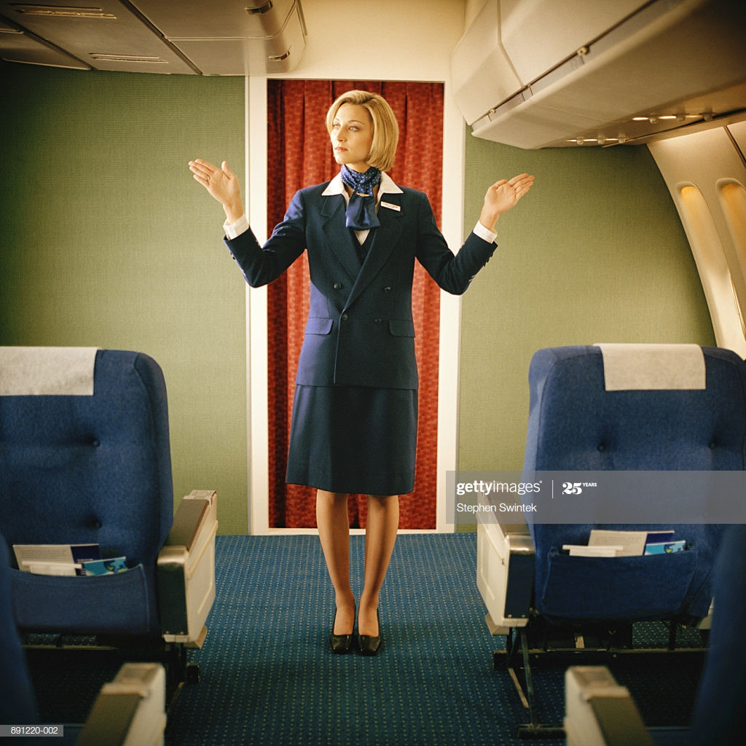
Aeroplane metaphor

Slide 2
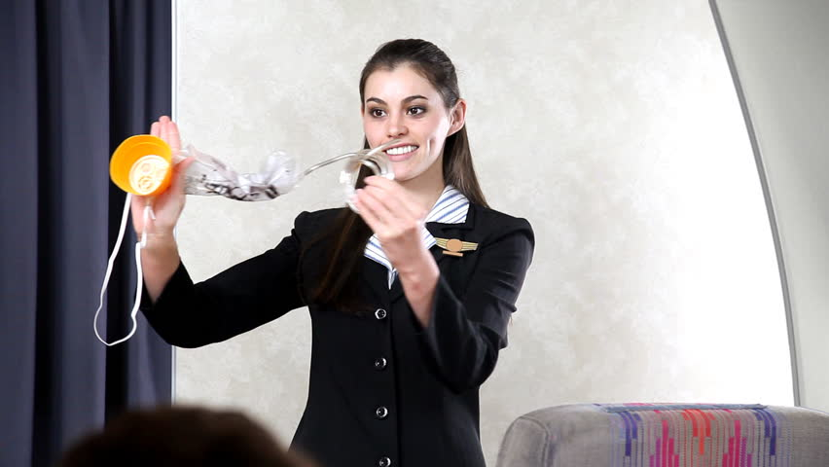
Aeroplane metaphor

Slide 3
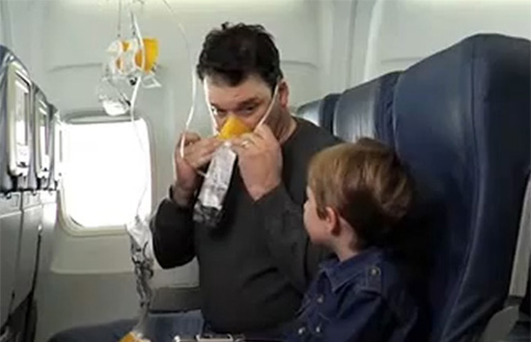
Aeroplane metaphor

